Slide 1


Unit 2-4 Business Process and Execution Reading: Textbook Sections 8.1 and 8.2
CSE446 / CSE598 Software Integration and Engineering
Unit 2 Software Development by Composition and Integration
Dr. Yinong Chen

Slide 2
Unit 2 Outline
Software Development by Composition and Integration
2-1
2-2
2-3
Enterprise Architecture and Business Process
Workflow Foundation 1: Concepts
Workflow Foundation 2: Case Study
BPEL (Business Process Execution Language)
Overview of Workflow and Orchestration
WSDL in BPEL
BPEL constructs and BPEL Process Definition
A Case Study of BPEL Application
Stateful Services
Development Frameworks Supporting BPEL
Oracle SOA Suite, BPMN, and BizTalk
2-4
Unit Test 2
2-5
2-6
Message-Based Integration
Web Caching and Recommendation
2-7
2-8

Slide 3
Organization of SOC-Enabling Technologies
Technologies supporting the functionality
Composition and Integration
Quality of Service
Service Broker
Service
Description
Knowledge
Description
Service
Protocols
Knowledge
Organization
Cloud Computing
Management
Policy Exchange
Introspection
Coordination & Transaction
Message Correlation
Reliability
Service Implementation and
Development Platforms
Security
Data and Resource Representation
Infrastructure
Computing and Communication Resources
Dependability of Service

Slide 4
Instances of the SOC-Enabling Technologies
Technologies supporting the functionality
C#, Java, BPEL, BPSS, OWL-S,
WF, WS-DCL, VIPLE
Quality of Service
UDDI / ebXML
WSDL
RDF, Prolog,
OWL
SOAP,
HTTP
Ontologies and
Frameworks
AWS Cloud Computing, Google App Engine,
IBM Clouds, Microsoft Azure,
WS Management
WS-Policy Exchange
WS-Coordination, WS-Transaction
WS-Reliable Messaging
WS-inspection
WS-Security
WS-Addressing
C#, C++, Java, VB
Eclipse, Visual Studio
XML, URI, Unicode
Intel SOI, Web Operating Systems
Dependability of Service

Slide 5
Composition and Business Process Languages
← 2016
Amazon
SWF
Intel IoT Orchestration
2015
Cloud Computing
/ Mashup
ASU
VIPLE
2014
Workflow
Foundation
Microsoft
VPL
2008
PSML-S
ASU
2007
2006
SCA/SDO
IBM
2005/11
2005/07
2004/12
2004/11
WS-CDL
W3C
2003/03
OWL-S
W3C
2002/08
BPEL1.1
OASIS
2002/06
BPEL1.0
BEA
IBM
Microsoft
Oracle
2002/03
WSCI
Sun
BEA
SAP
W3C
2001/06
WSCL
HP
2001/05
BPSS
ebXML
2001/03
WSFL
IBM
2000/05
BPMN
by BPMI
XLang
Microsoft
Web Service Choreography Interface

Slide 6
BPEL vs. other Composition Languages
Language | Architecture Style | Other features
BPEL 2002 | orchestration | Based on SOAP, WSDL, UDDI directory, widely used by large corps
BPSS 2001 BP Spec. Schema | choreography | Business Process Specification Schema Based on SOAP, ebXML repository, CPP/CPA collaboration, for small biz
BPMN 2001 BP Modeling Notation | orchestration | A superset of BPEL, supports advanced semantics & complex structures, by BPMI which merged with OMG in 2005
WSCI 2002 | choreography | WS Choreography Interface: Complementary to BPEL, submitted to W3C, not widely used
WS-CDL 2004 | choreography | Complementary to BPEL, W3C own proposal
PSML-S 2005 | choreography | From ASU. Focus on dynamic behaviors: dynamic discovery, matching, cooperation

Slide 7
Business Process vs. Workflow
A business process is a sequence or a collection of business activities, involving actors (humans or machines) and actions, to perform on business inputs and generated business results.
A workflow is a composition (programming) or flow management technology that organizes the components and services and defines their order of execution.
Workflow frameworks are designed to describe business processes, so that business process can be
precisely described or specified
executed automatically
Business Process
Workflow from Developer’s view

Slide 8
Composition Style: Orchestration
A central process, which can be a service itself, takes control over the involved services and coordinates the execution of different operations
Involved services communicate with the central process only, within the application;
How service functionality is achieved by aggregating other Web services
Useful for private business process, using independent services
BPEL uses this style
WS1
WS2
WS
Coordinator
WS3
WS4
Orchestration

Slide 9
Composition Style: Choreography
There is no central coordinator.
Each service involved can communicate with multiple partners within the application;
How to interact with individual services to consume its functionality
Useful for public business process involving coordinated design of distributed services
WS-CDL uses this style
WS1
WS2
WS5
WS3
WS4
Increasing complexity of composition, the line between the two styles is vanishing, and the styles are not emphasized.

Slide 10
Orchestration
Vs.
Choreography
Encoder
Serializer
Buffer
classes
Main
Object
String
Object
String
Store1
Producer
threads
. . .
Queue of strings
Bank
Consumer
thread
StoreN
Buffer queue
center
center

Slide 11
Amazon Simple Workflow (SWF)
http://docs.aws.amazon.com/amazonswf/latest/awsflowguide/
Amazon SWF provides a high-level way for developers to compose distributed and asynchronous workflow applications.
It is a programming environment that simplifies the process of defining workflow and thus simplifies the implementation of a business process using Amazon SWF.
It can be used for implementing a broad range of applications, including business processes, media encoding, long-running tasks (persistent), and background processing.

Slide 12
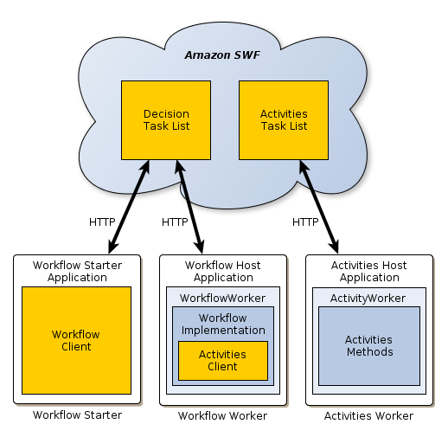
Amazon SWF Application Structure
Three-Party Model
4. Workflow developer registers app to SWF
5. SWF monitors, manages, coordinates, synchronizes the execution
2. Activity developer registers activities to SWF
6. Client (end user) accesses SWF without knowing its provider
3. Workflow developer writes the workflow that connects your activities, and host them as app
1. Activity developer writes the activity methods and host them anywhere on workers as services
End user
Developers

Slide 13
Creating Your Workflow in Amazon SWF
Write or discover existing activity methods that are needed in your workflow. Host your own services.
Write a decider to implement the coordination logic of your workflow.
Register your activities and workflow with Amazon SWF. You can do this step programmatically or by using the AWS Management Console.
Start your activity workers and decider.
Start one or more executions of your workflow.
View workflow executions using the AWS Management Console.
Note: The above process shows that you develop both activities and the workflow. Normally, you do not do both.
Service Provider
Service Consumer
Service Broker

Slide 14
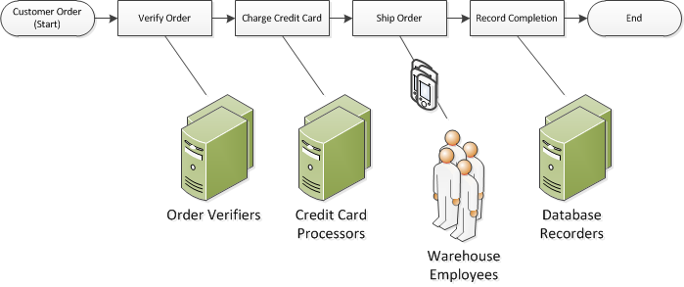
Amazon Workflow Example in E-Commerce
http://docs.aws.amazon.com/amazonswf/latest/developerguide/swf-dev-about-workflows.html
Actions
Actors
or robots
Partnership

Slide 15
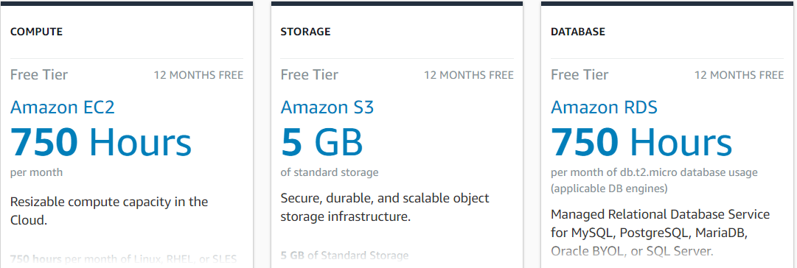
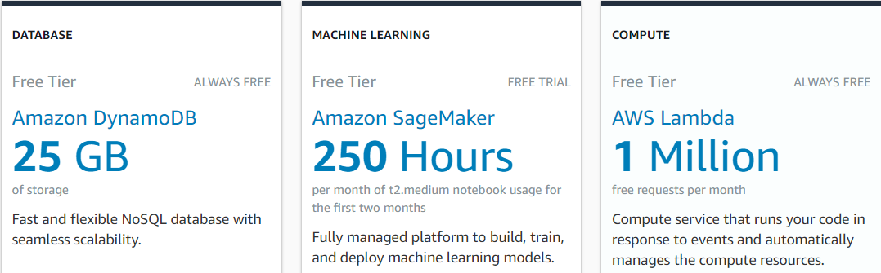
AWS Free Tier
https://aws.amazon.com/free/?all-free-tier.sort-by=item.additionalFields.SortRank&all-free-tier.sort-order=asc
https://aws.amazon.com/free/free-tier-faqs/

Slide 16
BPEL versus Workflow Foundation
Similarities (Considering the graphic view of BPEL)
Architecture-driven approach
Add another layer of abstraction to programming
Workflow/Process languages
Graphic tools for visual development, e.g., Oracle SOA Suite
Similar constructs
Executable
Differences
BPEL is more towards enterprise level software integration and is closer to the business architecture;
WF is closer to programming languages and allows to mix with programming languages, e.g., CodeActivity.

Slide 17
BPEL, BPEL4WS, WS-BPEL
http://download.boulder.ibm.com/ibmdl/pub/software/dw/specs/ws-bpel/ws-bpel.pdf
A BPEL process defines the structure of the interaction in terms of
participant services (partners)
Characterize partners
Provide support to partner conversation
business logic.
Data
Control flow
Error handling and recovery mechanisms

Slide 18
BPEL Partners: Input / Output of a Process
Partners:
A composition defines a new service that interacts with one or more partners.
A partner is characterized by the WSDL interface portType
Interactions between partners can be unidirectional or bidirectional. You may define
Synchronous and asynchronous interactions.
Stateless and Stateful.
How is the state maintained in stateful services?
BPEL correlation mechanism uses business data to maintain the state of the interaction.
Other middleware mechanisms are possible.

Slide 19
Developing a Business Process with BPEL
Partner
Link
Partner
Link
Client
WSDL portTpye
<receive>
WSDL portTpye
WS 1
Bi-
directional
<invoke>
<invoke>
Partner
Link
processing
WS 2
WSDL portTpye
Uni-
directional
<invoke>
<receive>
processing
<reply>
BPEL process as a composite Web service

Slide 20
BPEL Basic Activities
A BPEL process consists of steps, each step is an activity:
<invoke> Invoking a service
<receive> Waiting for receiving a message
<reply> Generating response to a synchronized service call
<assign> Modifying data variables
<throw> Jumping to an exception handler
<catch> Handling an exception
<wait> Waiting for a certain amount of time
<terminate> Terminating the entire process

Slide 21
BPEL Constructs
A BPEL process can use constructs to define complex activities:
<sequence> Define a set of activities that will be executed in the given order of sequence.
<flow> Define a set of activities that will (can) be executed in parallel.
<switch> Define a selection (if-then-else)
<while> Define a while-loop
<while condition="expr" standard-attributes>
standard-elements
activities
</while>
<pick> Define a list of activities. Execute the first activity that is available, e.g., can be used to block wait for a response, or timeout, whichever comes first.
<partnerLink> Define a partner link
<variable> Declare a variable

Slide 22
Process Example: Select the Best Insurance
Root element
<?xml version= "1.0" encoding="utf-8"?>
<process name="insuranceSelectionProcess" targetNamespace="http://bpelexample.com/bpel/example/" xmlns="http://schemas.xmlsoap.org/ws/2003/03/business-process/"
xmlns bpws="http://schemas.xmlsoap.org/ws/2003/03/business-process/"
xmlns:ins="http://bpelexample.com/bpel/insurance/"
xmlns:com="http://bpelexample.com/bpel/company/">
<partnerLinks>
<partnerLink name = "client"
partnerLinkType = "com:selectionLT"
myRole = "insuranceSelectionService"/>
<partnerLink name = "insuranceA"
partnerLinkType ="ins:insuranceLT"
myRole = "insuranceSelectionRequester"
partnerRole = "insuranceSelectionService"/>
<partnerLink name = "insuranceB"
partnerLinkType= "ins:insuranceLT"
myRole = "insuranceSelectionRequester"
partnerRole = "insuranceSelectionService"/>
</partnerLinks>
This business process has 3 partners:
Client, insureanceA, and insuranceB
①
One role
②
Two roles
③
Two roles

Slide 23
Example (contd.): Variables
<variables>
<!-- input for BPEL process -->
<variable name="InsuranceRequest"
messageType="ins:InsuranceRequestMessage"/>
<!-- output from insurance A -->
<variable name="InsuranceAResponse"
messageType="ins:InsuranceResponseMessage"/>
<!-- output from insurance B -->
<variable name="InsuranceBResponse"
messageType="ins:InsuranceResponseMessage"/>
<!-- output from BPEL process -->
<variable name="InsuranceSelectionResponse"
messageType="ins:InsuranceResponseMessage"/>
</variables>

Slide 24
Example (contd.): Sequence and Flow
<sequence>
<!-- Receive the initial request from client -->
<receive partnerLink="client"
portType="com:InsuranceSelectionPT"
operation="Selectlnsurance"
variable="InsuranceRequest"
createlnstance= "yes" />
<!-- Make concurrent invocations to Insurance A and B -->
<flow>
<!-- Invoke Insurance A web service -->
<invoke partnerLink="insuranceA"
portType="ins:ComputelnsurancePremiumPT"
operation="computelnsurancePremium"
inputvariable= "InsuranceRequest" outputVariable="InsuranceAResponse"/>
<!-- Invoke Insurance B web service -->
<invoke partnerLink="insuranceB"
portType="ins:ComputelnsurancePremiumPT"
operation="computelnsurancePremium"
inputvariable= "InsuranceRequest"
outputVariable="InsuranceBResponse"/>
</flow>

Slide 25
Example (contd.): Switch (if-then-else)
<!-- select the best offer and construct the response -->
<switch>
<case condition="bpws:getvariableData(‘InsuranceAResponse’, ‘confirmationData’, ‘/confirmationData/ins:Amount’)
&lt;= bpws:getvariableData(‘InsuranceBResponse’,
‘confirmationData’, ‘/confirmationData/ins : Amount’)">
<!-- select Insurance A -->
<assign>
<copy>
<from variable="InsuranceAResponse" />
<to variable="insuranceSelectionResponse" />
</copy>
</assign>
</case>

Slide 26
Example (contd.): Switch
<otherwise>
<!-- select Insurance B -->
<assign>
<copy>
<from variable="InsuranceBResponse" />
<to variable="InsuranceSelectionResponse" />
</copy>
</assign>
</otherwise>
</switch>
<!-- send a response to the client -->
<reply partnerLink="client"
portType="com:insuranceselectionPT"
operation="selectInsurance"
variable="InsuranceSelectionResponse"/>
</sequence>
</process>

Slide 27
The Root Element “process”
Define the qualifiers and namespaces of the process
Target namespace
Default namespace
Additional namespaces in which other names are defined
Read text chapter 4 if not familiar with XML
<?xml version="1.0" encoding="utf-8"?>
<process name="insuranceSelectionProcess" targetNamespace="http://bpelexample.com/bpel/example/" xmlns="http://schemas.xmlsoap.org/ws/2003/03/business-process/"
xmlns bpws="http://schemas.xmlsoap.org/ws/2003/03/business-process/"
xmlns:ins="http://bpelexample.com/bpel/insurance/"
xmlns:com="http://bpelexample.com/bpel/company/">
Default

Slide 28
Invoking Web Services in BPEL Process
BPEL supports two methods of two-way communication:
Synchronous:
Send a request to a WS, and block-wait for receiving the response;
Suitable for the situation where the result is expected in little time.
Asynchronous:
Send a request to a WS and start to take other activities.
Let the callee WS to call back;
Suitable for the situation where the result may take a long time
The caller must be a service, with a portType

Slide 29
Invoking Web Services in BPEL Process
portType
Client
Synchronous request
WS
Synchronous response
Client
Asynchronous request
WS
Callback to send response

Slide 30
Invoking WS Sequentially
<process>
<!– waiting for request to start processing -->
<receive … />
. . .
<!– Start to process the request by calling multiple WS one by one -->
<sequence>
<!-- Invoke Insurance web services -->
<invoke …/>
<invoke …/>
<invoke …/>
. . .
</sequence>
</process>

Slide 31
Invoking WS in Parallel
<process>
<!– waiting for request to start processing -->
<receive … />
. . .
<!– Start to process the request by calling multiple WS in parallel -->
<flow>
<!-- Invoke Insurance web services -->
<invoke …/>
<invoke …/>
<invoke …/>
. . .
</flow>
</process>

Slide 32
Invoking WS Sequentially and in Parallel
<process>
<!-- waiting for request to start processing -->
<receive … />
. . .
<!-- Start to process the request by calling multiple WS sequentially and in parallel -->
<sequence>
<flow>
<invoke …/>
<invoke …/>
. . .
</flow>
<flow>
<invoke …/>
<invoke …/>
. . .
</flow>
</sequential>
</process>
<invoke ../>
<invoke ../>
<invoke ../>
<invoke ../>
<invoke ../>
<invoke ../>

Slide 33
Each Business Process is a Web Service
Each BPEL process is typically a composite Web service, with the following features
Clients will call the process as a WS;
At least one WS will be called by the process (otherwise, it is not a composite WS)
A process will have a WSDL file to define how the clients or other WS can call the process
A process can offer synchronous and asynchronous communication methods to the clients or other WS.

Slide 34
WSDL portType of the BPEL Process
BPEL Process
Web Service
portType
A
Async request
portType
portType
B
Callback to send response
Consider the WSDL portType: A and B
The BPEL process offers portType A to the client
The BPEL process offers portType B for the WS to callBack
The BPEL process will access the portType offered by WS

Slide 35
PartnerLinkType for BPEL Process in WSDL
A new element, called PartnerLinkType is added into the WSDL file of the process,
using the extensibility of WSDL.
This element does not have to be in the services that interact with the BPEL process.
BPEL Process’s WSDL
BPEL Process
(Executable Code)
Web Service
PartnerLinkType
portType
Role 1
portType
portType A
Role 2
portType
portType B

Slide 36
WSDL File of the BPEL Process
<?xml version= "l.0" encoding="UTF-8"?>
<definitions
xmlns:http="http://schemas.xmlsoap.org/wsdl/http/"
xmlns:soap="http://schemas xmlsoap.org/wsdl/soap/"
xmlns:xs= "http://www.w3.org/2001/XMLschema"
xmlns: soapenc="http://schemas.xml soap.org/soap/encoding/"
xmlns :ins="http://bpelexample.com/bpel/insurance/"
xmlns : com="http://bpelexample.com/bpel /company/"
targetNamespace ="http://bpelexample.com/bpel/company/"
xmlns="http://schemas.xmlsoap.org/wsdl/"
xmlns : plnk= "http://schemas.xmlsoap.org/ws/2003/05/partner-link/" >
<types>
<xs:schema ... >
</xs:schema>
</types>
<message ... >
<part ... />
</message>
Default
Additional namespace

Slide 37
WSDL File of the BPEL Process (contd.)
<portType name="computeInsurancePremiumPT">
<operation name="...">
<input message="..." />
<output message="..." />
</operation>
</portType>
<portType name="ComputeInsurancePremiumCal1backPT">
<operation name="...">
<input message="..."/>
</operation>
</portType>
<plnk:partnerLinkType name=insuranceLT>
…
</plnk: partnerLinkType>
Next page

Slide 38
WSDL File of the BPEL Process (contd.)
<plnk:partnerLinkType name=insuranceLT>
<plnk:role name= "insuranceService">
<plnk:portType name="ins:computeInsurancePremiumPT"/>
</plnk: role>
<plnk: role name="insuranceRequester">
<plnk:portType name="ins:ComputeInsurancePremiumCallbackPT"/>
</plnk: role>
</plnk: partnerLinkType>
</definitions>

Slide 39
WSDL with the plnk extension
definitions, service name, namespaces
Service
port
port
binding
binding
partnerLinkType
. . .
partnerLinkType
portType
portType
operation
operation
message, in
. . .
message, in
type
type
message, out
message, out
Type
type

Slide 40
Define the process with the partnerLink using partnerLinkType
<?xml version="1.0" encoding="utf-8"?>
<process name="insuranceSelectionProcess"
targetNamespace="http://bpelexample.com/bpel/example/"
xmlns="http://schemas.xmlsoap.org/ws/2003/03/business-process/"
xmlns bpws="http://schemas.xmlsoap.org/ws/2003/03/business-process/"
xmlns:ins="http://bpelexample.com/bpel/insurance/"
xmlns:com="http://bpelexample.com/bpel/company/">
<partnerLinks>
<partnerLink name= "client"
partnerLinkType = "com:selectionLT"
myRole="insuranceSelectionService"/>
<partnerLink name = "insuranceA"
partnerLinkType = "ins:insuranceLT"
myRole = "insuranceSelectionRequester"
partnerRole = "insuranceSelectionService"/>
<partnerLink name = "insuranceB"
partnerLinkType = "ins:insuranceLT"
myRole = "insuranceSelectionRequester"
partnerRole = "insuranceSelectionService"/>
</partnerLinks>
Partner
Link
Partner
Link
Client
portTpye
<>
portTpye
WS
1
<>
<>
Partner
Link
portTpye
WS
2
<>
<>
<>

Slide 41
Using the partnerLink in the BPEL Process
<receive partnerLink="client"
portType="com:InsuranceSelectionPT"
operation="Selectlnsurance"
variable="InsuranceRequest" createlnstance= "yes" />
<flow>
<invoke partnerLink= "insuranceA"
portType= "ins:ComputelnsurancePremiumPT"
operation= "computelnsurancePremium"
inputvariable= "InsuranceRequest"
outputVariable= "InsuranceAResponse"/>
<invoke partnerLink= "insuranceB"
portType= "ins:ComputelnsurancePremiumPT"
operation= "computelnsurancePremium"
inputvariable= "InsuranceRequest"
outputVariable="InsuranceBResponse"/>
</flow>

Slide 42
BPEL Variables
BPEL business processes model the exchange of messages between involved web services.
Messages are exchanged as operations are invoked.
When the business process invokes an operation and receives the result, we often want to store that result for subsequent invocations, use the result as is, or extract certain data.
BPEL provides variables to store and maintain the state.
Variables can also hold data that relates to the state of the process, but will never be exchanged with partners.

Slide 43
Declaration of Variables
BPEL Variables are typed. Variables can be declared in one of the following kinds:
messageType: A variable that can hold a WSDL message;
element: A variable that can hold an XML Schema element;
type: A variable that can hold an XML Schema simple type.
<variables>
<variable name = "InsuranceRequest"
messageType = "ins:InsuranceRequestMessage"/>
<variable name = "PartialInsuranceDescription"
element ="ins:InsuranceDescription"/>
<variable name= "LastName"
type="xs:string" />
</variables>

Slide 44
Global Variables
You can declare variables globally at the beginning of a BPEL process declaration document.
The following example shows the structure of a BPEL process that uses variables:
BPEL Process
BPEL Process’s WSDL
<process ...>
<partnerLinks>
…
</partnerLinks>
<variables>
<variable ... />
<variable .../>
</variables>
<sequence>
…
</sequence>
</process>
PartnerLinkType
Role 1
portType
portType A
Role 2
portType
As the direct child of the root element <process>
portType B

Slide 45
Scope and Local Variables and Handlers
Scopes
provide a way to divide a complex business process into hierarchically organized parts;
provide behavioral contexts for activities;
allow us to define different fault handlers for different activities;
can be defined within <sequence> or <flow>.
provide a way to declare local variables that are visible only within the scope.
allow us to define local correlation sets, compensation handlers, and event handlers

Slide 46
Local variables within the given “scope”
<sequence>
<scope>
<variables>
<!-- variable definitions local to the scope -->
</variables>
<correlations>
<!-- correlation sets -->
</correlations>
<compensationHandler>
<!-- Compensation handlers local to the scope -->
</compensationHandler>
<eventHandlers>
<!-- Event handlers local to the scope -->
</eventHandlers>
</scope>
<faultHandlers>
<!-- Fault handlers local to the scope -->
</faultHandlers>
…
</sequence>
The scope does not apply to these faultHandlers

Slide 47
Exception Handlers
<process>
<partnerLinks>
…
</partnerLinks >
<variables>
…
</variables>
<faultHandlers>
<catch ...>
<!– perform an activity -->
</catch>
<catch ...>
<!– perform an activity -->
</catch>
<catchAll>
<!– perform activity.
catchAll is optional -->
</catchAll>
</faultHandlers>
…
</process>
<faultHandlers>
<catch faultName="trv:TicketNotApproved" >
<!-- First fault handler -->
<!-- Perform an activity -->
</catch>
<catch faultName="trv:TicketNotApproved" faultvariable="TravelFault" >
<!-- Second fault handler -->
<!-- Perform an activity -->
</catch>
<catch faultvariable="TravelFault" >
<!-- Third fault handler -->
<!-- Perform an activity -->
</catch>
<catchAll>
<!-- Perform an activity -->
</catchAll>
</faultHandlers>

